Slide 1
Software Architecture for Essential and Accidental Uncertainty
Neil Harrison
with George Rudolph, Peter Aldous
Utah Valley University

Slide 2
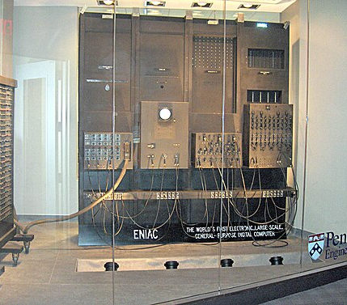
Introduction: A bit of History
The ENIAC: Electronic Numerical Integrator and Computer
First general-purpose computer to solve “a large class of numerical problems”
(Note that these numerical problems were precisely defined and results could be deterministically computed)

Slide 3
Progress: More Applications
Business Applications
Variation in amount and nature of input data
Data Communication
Data transmission issues: timing, failure, corruption, etc.
Control Systems
Must handle all different problems reliably
Artificial Intelligence
Unknown inputs, unknown outputs

Slide 4
History: Summary
Originally, problems solved by computers were mathematical: precisely specified, with precisely defined outputs and precisely defined algorithms (even if you didn’t know the exact answer yet.)
As software capabilities increased, the inputs, outputs, and even processing approaches have become less precise: we must deal with uncertainty
Therefore, it is necessary to understand uncertainty, and how to approach it

Slide 5
Current State of the Art
2010: David Garlan called for uncertainty to be a first-class concern in software design and development
(Actually, he was a bit late to the party …)
Uncertainty research and practice is ENTIRELY focused on fault tolerance and similar approaches
This misses a large part of uncertainty
And demands an in-depth investigation of the nature of uncertainty

Slide 6

(Yet more history)
Frederick ​P. Brooks 1986: “No Silver Bullet: Essence and Accidents in Software Engineering”
Accidental Complexity: problems that engineers create and fix. For example, modern programming languages have abstracted away the details of writing and optimizing assembly language code.
Essential Complexity: is caused by the problem to be solved, and nothing can remove it; if users want a program to do 30 different things, then those 30 things are essential and the program must do those 30 different things.
Likewise, there is essential and accidental uncertainty.

Slide 7
Essential and Accidental Uncertainty
Accidental uncertainty: Uncertainty that can be separated from the problem at hand. There exists a transformation that removes the uncertainty.
Essential uncertainty: Uncertainty that must be addressed as part of the problem. No transformation can exist that removes the uncertainty from the problem.

Slide 8
Uncertainty and Data
Uncertainty can be characterized by considering the data of a system
After all, computing is processing of data
Consider the following:
Uncertainty of the input (can be essential or accidental)
Uncertainty of the output (generally essential)
Uncertainty in the transformation from input to output (can be essential or accidental)

Slide 9
Input: Uncertainty Examples
Unreliable data transmission:
Accidental, because not part of the essence of the data. Datacomm protocols implement transformations to remove the uncertainty
Amount of data being processed:
Often accidental, because we can often handle it in subsets
User input errors
Accidental: parse for correctness and re-prompt
Multiple concurrent access to the system
Accidental, if we can handle the discretely
Essential, if not (e.g., a venue ticket website, requests for the same seat)

Slide 10
Input Uncertainty
Other cases of input uncertainty exist that are essential.
We will discuss these later

Slide 11
Uncertainty in the Transformation
By itself, it is generally kind of accidental.
Examples:
Hardware glitches during processing: accidental, approaches include duplication of hardware
Different compilers produce different programs that do the same thing: we generally don’t care, as long as differences in performance doesn’t become an issue
The interesting cases are associated with output uncertainty

Slide 12
Output Uncertainty
Accidental uncertainty of output is generally not very interesting.
Essential output uncertainty spans a wide spectrum of the nature of the uncertainty
It requires a corresponding spectrum of architectural and design approaches.

Slide 13
Essential Output Uncertainties
Output Characteristics | Example
There is a known right answer | Mathematical computation
The right answer(s) can be known | Sales Website (how well did a product sell?)
There is a right answer, but is infeasible to compute directly | Game of Go (estimated 10^10^48 to 10^10^170 possible games)
Unknown right answer, but can guess | Image recognition

Slide 14
More …
Output Characteristics | Example
The effect is unknown, but can be measured | Optimization problems
The effect is unknown; the system is chaotic | Weather forecasting
No specific answer, but can observe “right” or “wrong” direction | Advertising, many simulation problems
No single right answer, and the problem is vague | Automated prose writing
The problem itself is unknown | Grounded theory

Slide 15
Thought Question
How would you characterize (automatic) software coding?
Answer: it’s a trick question. It depends on the nature of the software being written.
Can you precisely specify what the generated software should do?
If not, how in the world can you verify it???

Slide 16
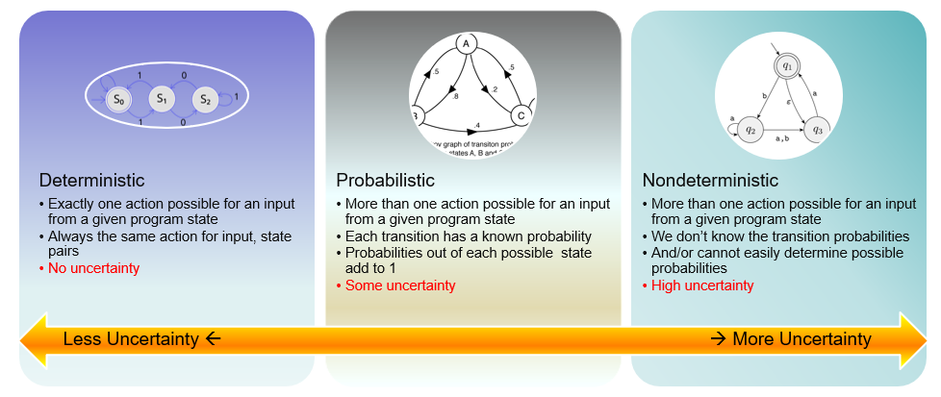
Spectrum of Uncertainty

Slide 17
Architectural Approaches
Different levels and characteristics of uncertainty suggest different architectural approaches, including patterns, styles, and tactics
Virtually no uncertainty: Batch processing
Pipes and Filters, Layers, Broker: well-suited for certain types of accidental uncertainty
Greater essential uncertainty leads to AI-based approaches
Blackboard
Neural network
Machine learning, deep learning

Slide 18
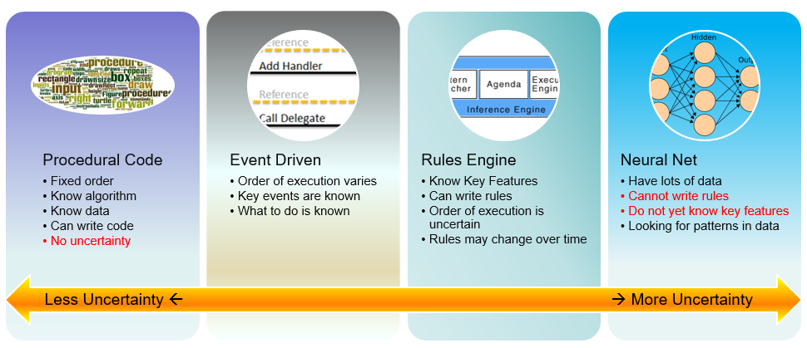
Spectrum of Architectural Approaches

Slide 19
An Architecture Process for Uncertainty
Identify the uncertainties associated with the system
For each, determine if it is essential or accidental
Study the source of the uncertainty (external is usually accidental)
Determine if there is a transformation to remove the uncertainty
If so, use techniques such as fault tolerance

Slide 20
3. Analyze Uncertainties
Analysis of the Input Data:
It is because of imprecise/incomplete specification?
It is because if variability in the data (such as transmission, user input errors, etc.)?
What can and cannot be known about the data at runtime?

Slide 21
Analysis of the Output Data:
What is the objective of the system, how can we know if it meets its objective?
Is there a known correct output?
Is there a correct output, but we cannot know if it is correct?
Can the output be correctly and deterministically derived from the inputs?
Are there multiple correct outputs?
If there are multiple correct outputs, is one more preferable to others?

Slide 22
Analysis of Transformation from Input to Output
Is the relationship between input and output deterministic?
If it is deterministic, is it tractable?

Slide 23
Case Study (Real Life)
Helicopter Rotor Balancing
If the main rotor of a helicopter is not perfectly balanced, it causes excess vibration
Vibration causes excess wear, loss of power, and even compromised safety
The main rotor is a complex system, with several different adjustment points.

Slide 24
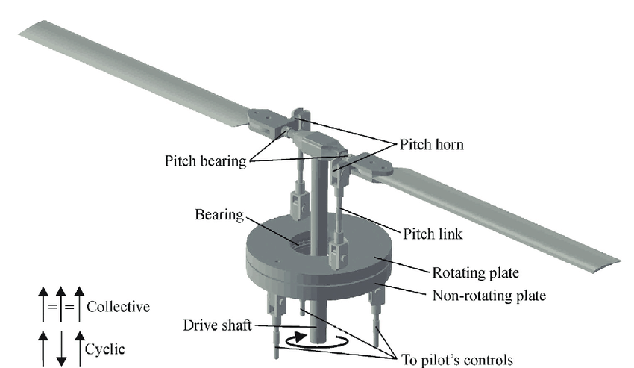

Slide 25
Uncertainty Analysis: Input
Input is known, and precisely specified:
Vibration of the rotor can be precisely measured
Positions of blades and adjustment points
History of adjustments/response (!) (was missed!)
Uncertainty: possible user error in entering data
External: consider standard FT techniques
Uncertainty: each helicopter has unique wear patterns
(Key! But was not considered!)

Slide 26
Uncertainty Analysis: Output
Overall objective known and can be measured: how much did the vibration change?
Desired output is a range: lower vibration is better, of course. ☺
Standard of acceptable vibration (0.5 IPS, inches per second)
Single solution? There may be different sets or sequences of adjustments to achieve the goal.

Slide 27
Uncertainty Analysis: Processing
Is the relationship between input and output deterministic?
Unknown!
Combinations of adjustments did not appear to deterministically result in reduced vibration: the system appeared to be chaotic.
Therefore:
Use a neural network to derive a suggested solution.

Slide 28
However:
The analysis had not fully considered all the aspects of the input, output, and processing!
Individual differences of each helicopter
History of adjustments and responses

Slide 29
Further Analysis Revealed:
Each helicopter has a unique wear profile
Neural network approach was based on many samples from many different helicopters! A generic approximation!
The adjustment/response history reveals the unique profile
There is a sequence of adjustments that is deterministic and repeatable
Employs feedback loops
Other details are proprietary

Slide 30
Results
System can reliably balance main rotors to 0.05 IPS, 10x better than the standard.
System is actively being marketed to US Army and other governmental and private organizations.
Demonstrates the importance and effectiveness of understanding the essential and accidental uncertainty of a system

Slide 31
Case Study: Online Bookstore
Initially:
Input and output analysis:
Input and output well specified.
Numerous accidental uncertainties, such as unreliability of the network.
Straightforward

Slide 32
Case Study: Bookstore evolution
Add a “related books” feature
Which books are related to the selected book?
An essential uncertainty
Output cannot be known beforehand
Not one single right answer
Approaches are not deterministic, but are probabilistic

Slide 33
Case Study: Bookstore evolution II
Examine browsing history to promote products
Even more uncertainty
Problem is less well defined
Consider machine learning
See uncertainty spectrum as discussed earlier

Slide 34
References
Harrison, N.B., Rudolph, G., and Aldous, P. Software Architecture for Essential and Accidental Uncertainty, Hawaii International Conference on the System Sciences (HICSS), 2026.
Harrison, N.B., Rudolph, G., and Aldous, P. Is Artificial Intelligence the Answer to Everything?, 2025 Intermountain Conference on Engineering, Technology and Computing (IETC), 2025.

Slide 35
Thank you!
Questions?

